Slide 1
Capital Budgeting & Project Risk
A firm that uses one discount rate for all projects may over time increase the risk of the firm while decreasing its value.
Project IRR
The SML can tell us why:
Incorrectly accepted negative NPV projects
Hurdle rate
Incorrectly rejected positive NPV projects
r_{f}
Firm’s risk (beta)
β_{FIRM}

Slide 2
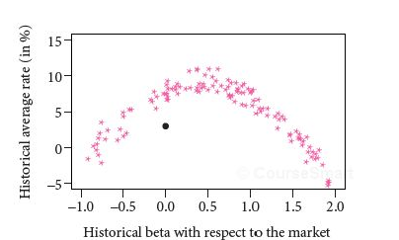
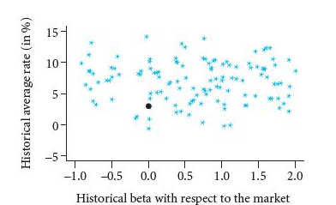
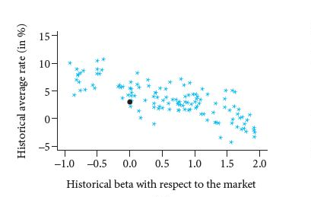
SML in Non-CAPM Worlds

Slide 3
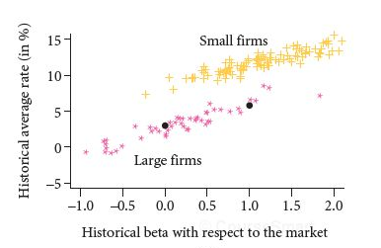
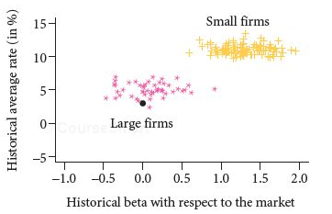
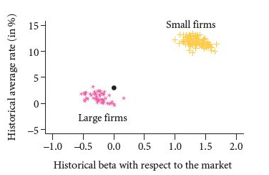
SML in Non-CAPM Worlds

Slide 4
Testing the CAPM
Expected values vs. realized values for R_{m}, β, and R_{m}- R_{f}
Right theory, wrong ruler; right ruler, wrong theory
Results
Relationship between estimated β and R is weaker than CAPM suggests (slope of SML is flatter than predicted by theory)

Slide 5
Testing the CAPM
Beta vs. Average Risk Premium
Avg Risk Premium 1931-2002
30
20
10
0
SML
Investors
Market Portfolio
Portfolio Beta
1.0

Slide 6
Testing the CAPM
Beta vs. Average Risk Premium
Avg Risk Premium 1931-65
SML
30
20
10
0
Investors
Market Portfolio
Portfolio Beta
1.0

Slide 7
Testing the CAPM
Beta vs. Average Risk Premium
Avg Risk Premium 1966-2002
30
20
10
0
SML
Investors
Market Portfolio
Portfolio Beta
1.0

Slide 8
Rates of Return and Market Betas (’70-’03)

Slide 9
Fama and French
FF (1992) have found:
The market capitalization or size of a firm is a predictor of its average historical return
Stocks with low market-to-book ratios tend to have higher returns than stock with high market-to-book ratios.
Differences in beta do NOT explain these differences
FF proposed a three-factor (now 5!) model for expected returns based on:
the difference between the returns of small stocks and big stocks (R_{SMALL} – R_{BIG})
the market premium (R_{M} – R_{f}) and
the difference between the returns of high and low B/M stocks (R_{HIGHBM} - R_{LOWBM})
FF (‘92):
FF (‘15): 2 additional factors:
Operating Profitability (RMW) & Investment (CMA)

Slide 10
Fama and French
Company Size versus Average Return
Return
Company Size
Largest
Smallest

Slide 11
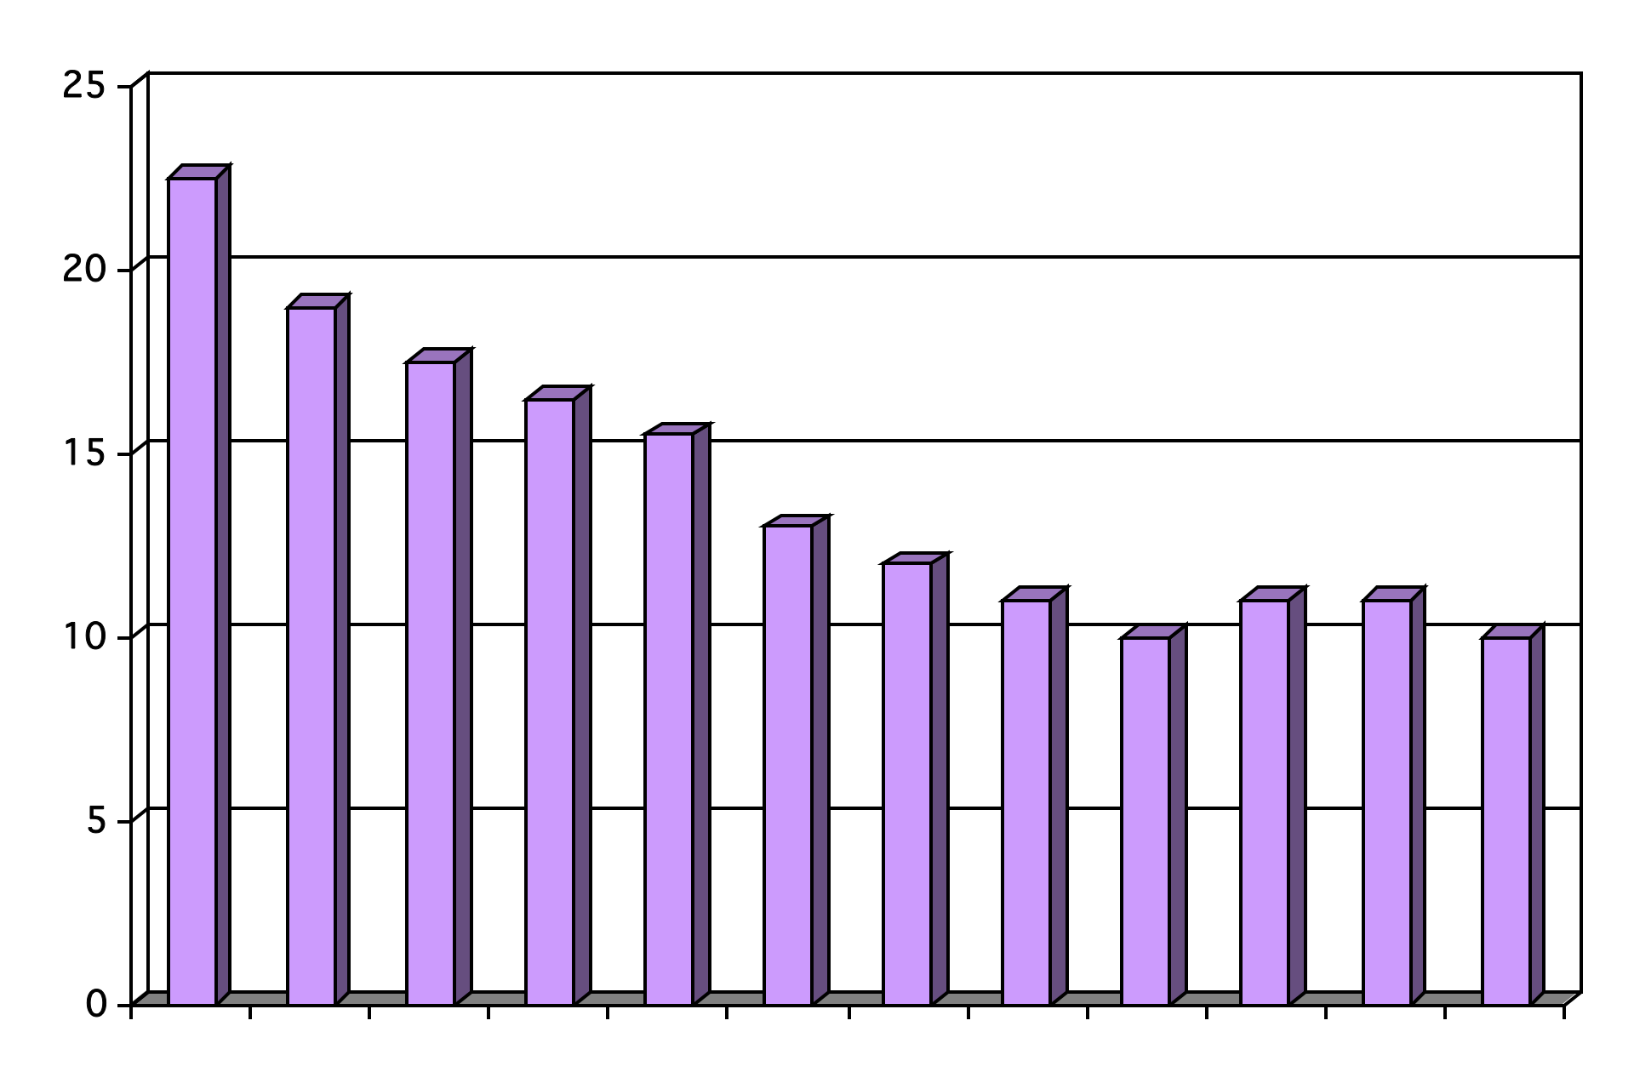
Fama and French
Book-Market versus Average Return
Return
Highest
Book-Market Ratio
Lowest

Slide 12
Size Effect: Illusion?
In the earliest days of empirical work in academic finance, the size effect was the first market anomaly to challenge the standard asset pricing model and prompt debates about market efficiency. The notion that small stocks have higher average returns than large stocks, even after risk-adjustment, was a pathbreaking discovery, and for decades it has been taken as an unwavering fact of financial markets. In practice, the discovery of the size effect fueled a crowd of small cap indices and active funds to a point where the investment landscape is now segmented into large and small stock universes. However, despite its long and illustrious history in academia and its commonplace acceptance in practice, there is still confusion and debate about the size effect. We examine many claims about the size effect and aim to clarify some of the misunderstanding surrounding it by performing simple tests using publicly available data. For one, using 90+ years of U.S. data, there is no evidence of a pure size effect, and moreover, it may not have existed in the first place, if not for data errors and insufficient adjustments for risk and liquidity.
Fact, Fiction, and the Size Effect, Alquist, Israel, Moskowitz (June 2018)

Slide 13
Fama and French
 | All Firms (%) | Low Betas (%) | High Betas (%)
All Firms | 15 | 16.1 | 13.7
Small Cap | 18.2 | 20.5 | 17
Large Cap | 10.7 | 12.1 | 6.7
 | All Firms | High ME/BE | Low ME/BE
All Firms | 14.8 | 7.7 | 19.6
Small Cap | 17.6 | 8.4 | 23
Large Cap | 10.7 | 11.2 | 14.2
Fama and French (1992). Data from ’63-’90

Slide 14
Fama-French
 | Three-factor Model |  |  |  | CAPM
 | B(Market) | B(Size) (Sm - Large) | B(HBk-LBk) | E(r)-r_{f} | E(r)-r_{f}
Computers | .90 | .17 | -.49 | 2.49 | 5.29
Petroleum & Gas | .96 | -.35 | .21 | 4.93 | 4.32
Factor Risk Premiums (’63-’94):
Market: 5.2%
Size: 3.2%
HBM-LBM: 5.4%
Source: Fama & French (‘97)

